Slide 1
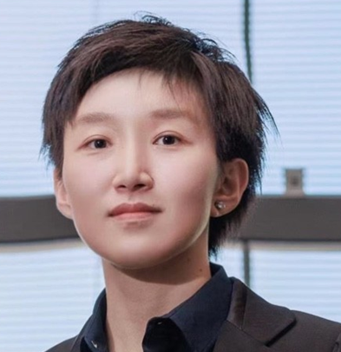

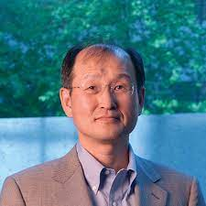
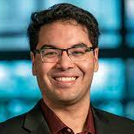


Uncertainty Quantification for Machine Learning via PAC Prediction Sets
Edgar Dobriban, University of Pennsylvania
With: Wenwen Si, Sangdon Park, Insup Lee, Osbert Bastani
Slides adapted from Osbert Bastani

Slide 2
Trustworthy Machine Learning & Safe AI
Machine learning is increasingly used in safety-critical settings
Robotics
Healthcare
Need to ensure these systems are trustworthy and safe

Slide 3

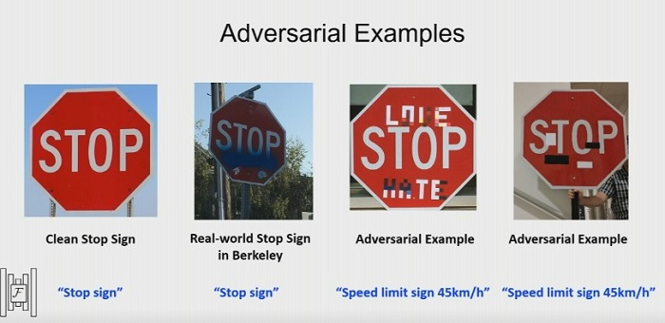
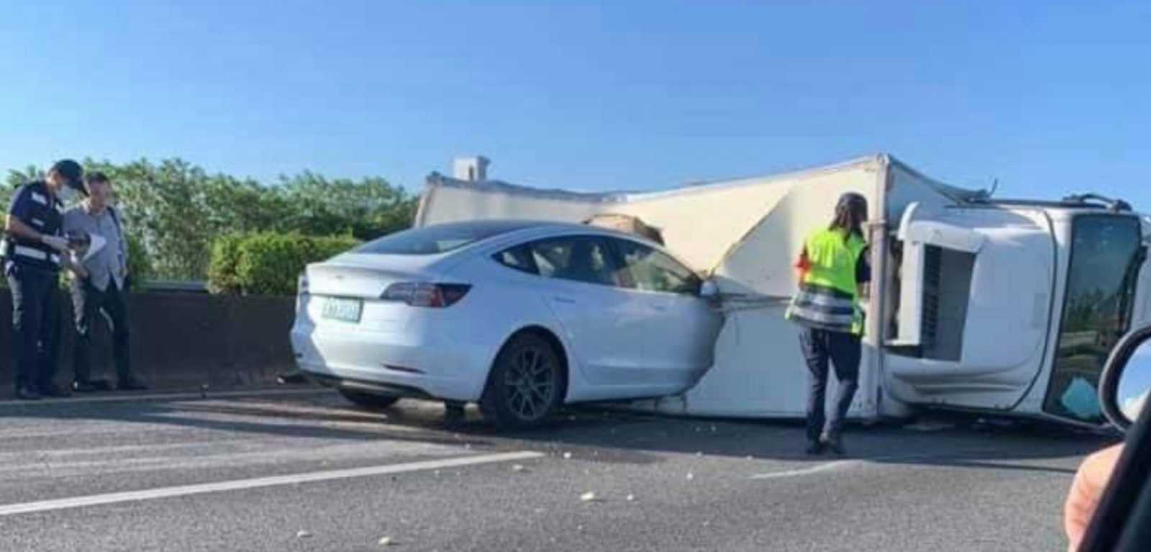
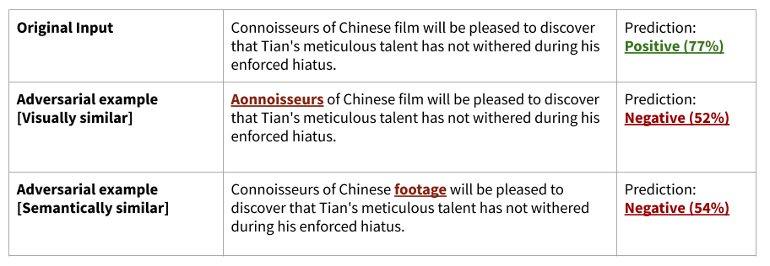
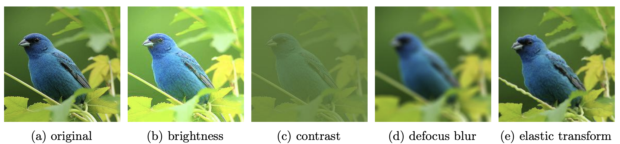
ML Systems are Prone to Failure

Slide 4
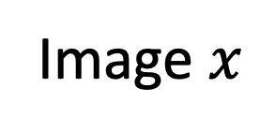
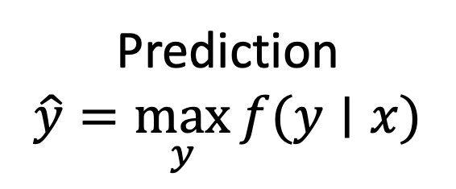
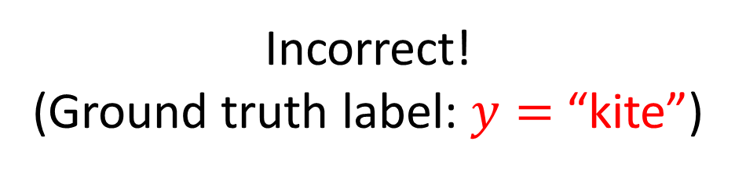
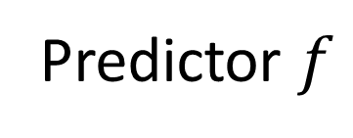
Imperfect Predictions
Incorrect!
(Ground truth label: $y=$ “kite”)
No Predictor achieves 100% accuracy
“vulture”
Prediction
$$\hat{y}=\max_{y}{f(y∣x)}$$
Image $x$
Predictor $f$

Slide 5
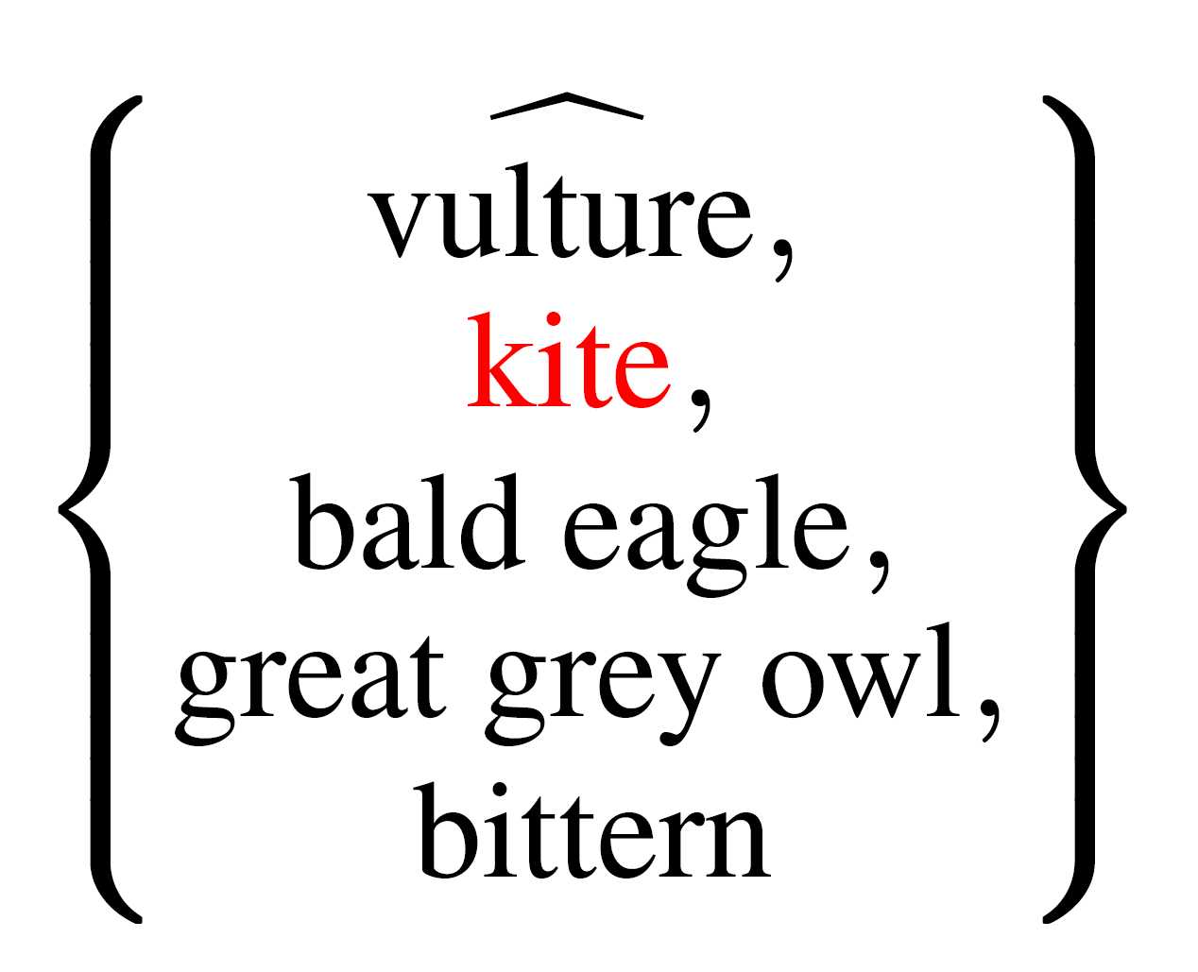
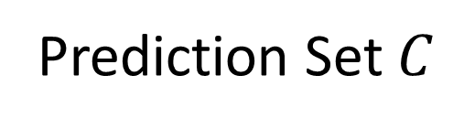
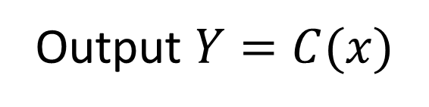

Prediction Sets
Image $x$
Prediction Set $C$
Output $Y=C(x)$
Idea: Modify predictor $f$ to predict sets of labels

Slide 6
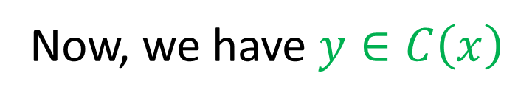
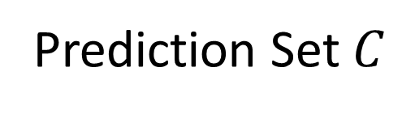
Prediction Sets
Now, we have $y∈C\left(x\right)$
Image $x$
Prediction Set $C$
Output $Y=C(x)$
Idea: Modify predictor $f$ to predict sets of labels

Slide 7
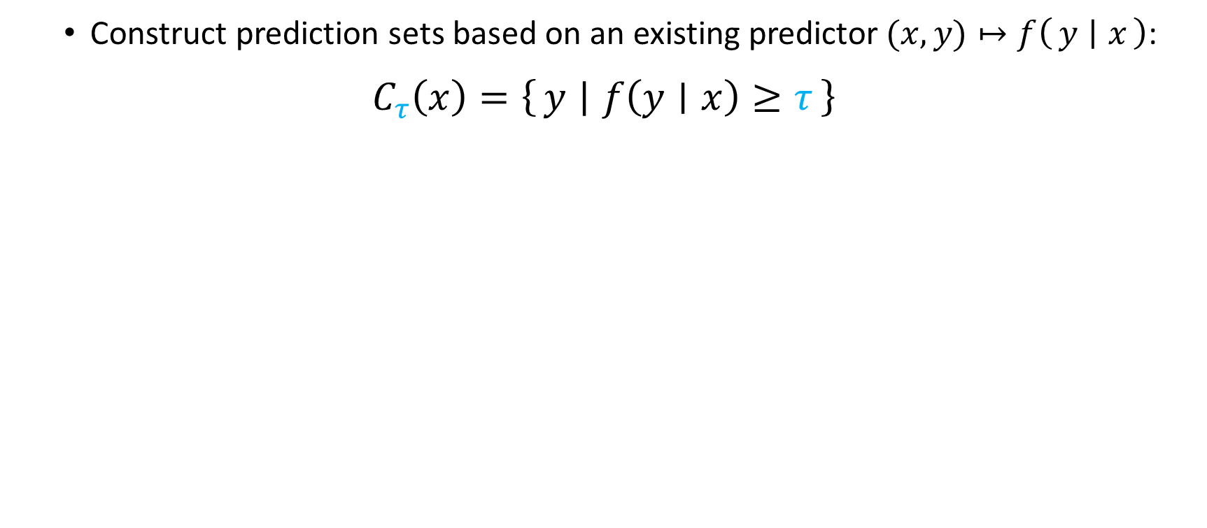
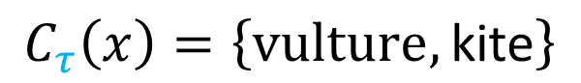
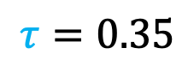
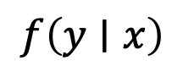
Prediction Sets
Construct prediction sets based on an existing predictor$(x,y)↦f\left(y ∣ x\right)$:
$$C_{τ}\left(x\right)=\left\{y ∣ f\left(y∣x\right)≥τ\right\}$$
$$τ=0.35$$
$$f\left(y∣x\right)$$
bald eagle (0.1)
kite (0.4)
vulture (0.5)
$$C_{τ}\left(x\right)=\left\{vulture,\text{kite}\right\}$$
Notes:
Dense slide to parse
Need a picture showing overall structure of how this thing is used

Slide 8
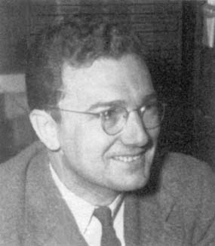
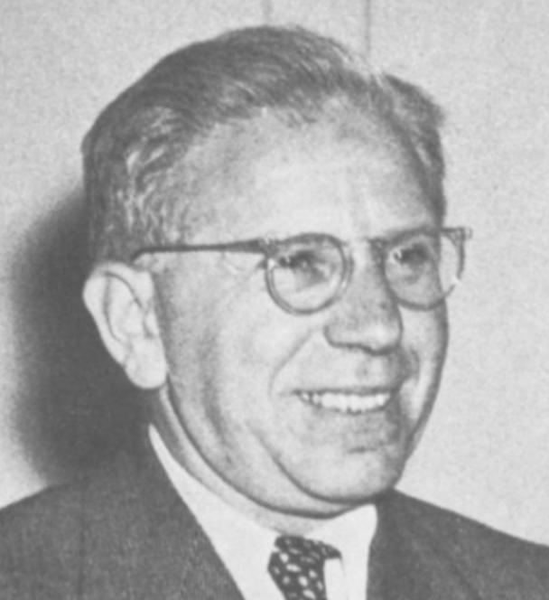

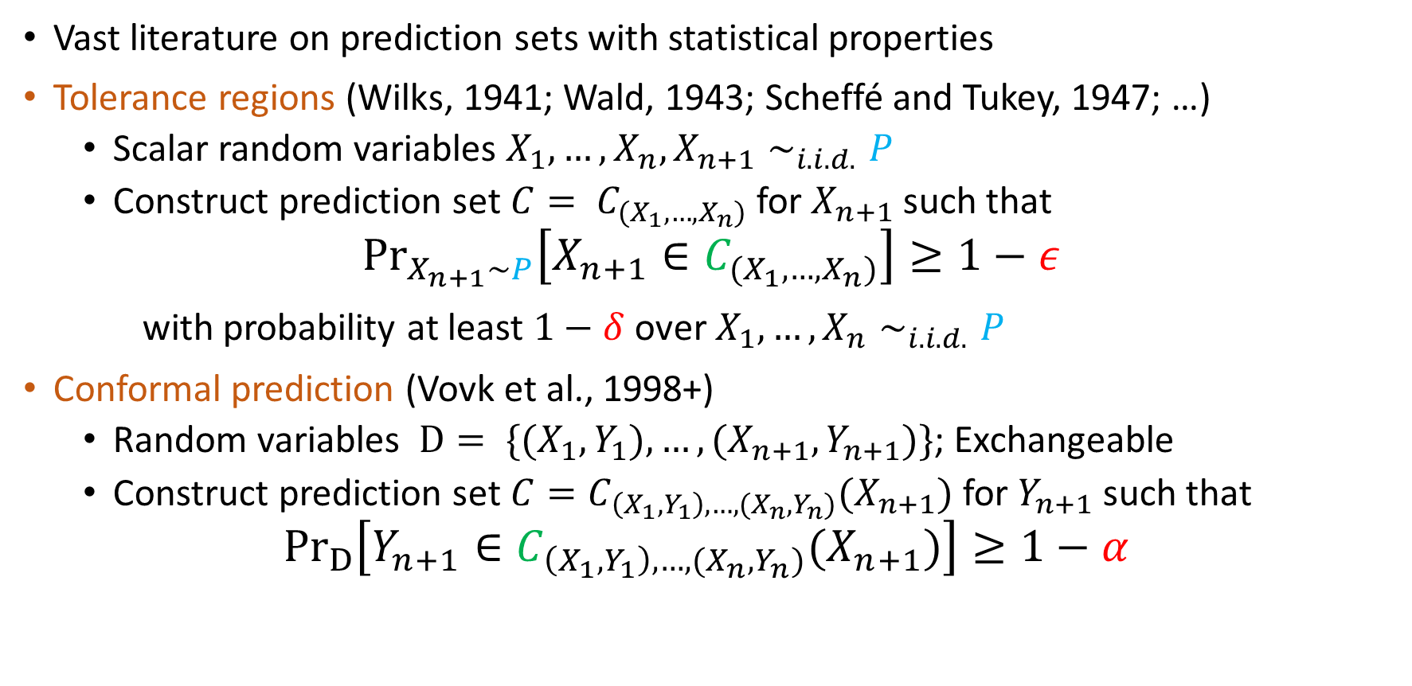
Prediction Sets with Statistical Properties
Vast literature on prediction sets with statistical properties
Tolerance regions (Wilks, 1941; Wald, 1943; Scheffé and Tukey, 1947; …)
Scalar random variables $X_{1}, …,X_{n}, X_{n+1}∼_{i.i.d.}P$
Construct prediction set $C= C_{(X_{1}, …,X_{n})}$ for $X_{n+1}$such that
$${Pr}_{X_{n+1}∼P}\left[X_{n+1}∈C_{(X_{1}, …{,X}_{n})}\right]≥1−ε$$
with probability at least $1−δ$ over $X_{1}, …,X_{n}∼_{i.i.d.}P$
Conformal prediction (Vovk et al., 1998+)
Random variables $D= \{(X_{1},Y_{1}),…,(X_{n+1},Y_{n+1})\}$; Exchangeable
Construct prediction set $C=C_{\left(X_{1},Y_{1}\right),…,(X_{n},Y_{n})}(X_{n+1})$for $Y_{n+1}$such that
$${Pr}_{D}\left[Y_{n+1}∈C_{\left(X_{1},Y_{1}\right),…,(X_{n},Y_{n})}(X_{n+1})\right]≥1−α$$
Samuel S. Wilks
Abraham Wald
Vladimir Vovk
Notes:
Animate

Slide 9
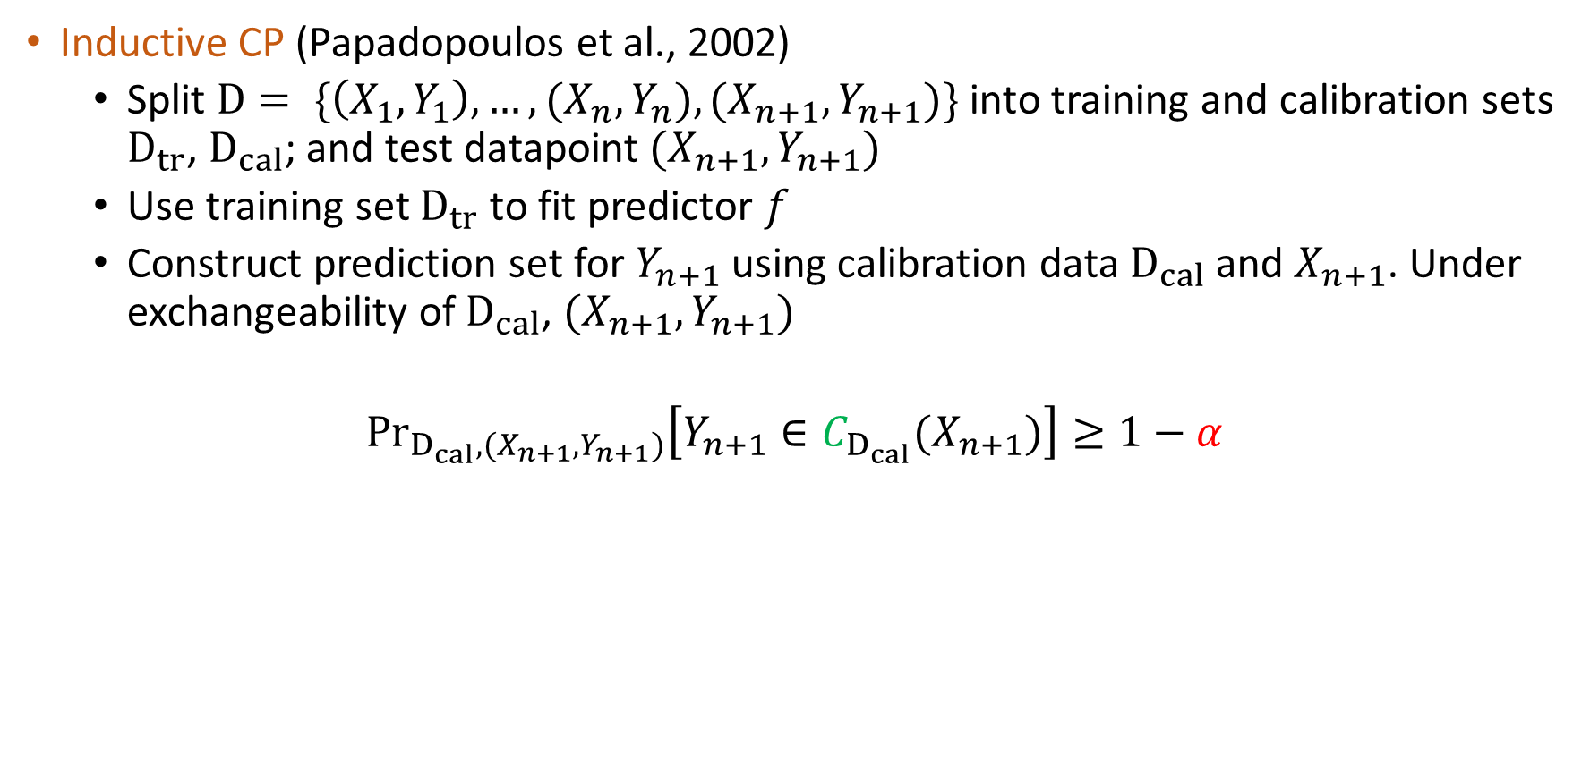
Inductive Conformal Prediction
Inductive CP (Papadopoulos et al., 2002)
Split $D= \{\left(X_{1},Y_{1}\right),…,(X_{n},Y_{n}),(X_{n+1},Y_{n+1})\}$ into training and calibration sets $D_{tr}$, $D_{cal}$; and test datapoint $(X_{n+1},Y_{n+1})$
Use training set $D_{tr}$ to fit predictor 𝑓
Construct prediction set for $Y_{n+1}$ using calibration data $D_{cal}$ and $X_{n+1}$. Under exchangeability of $D_{cal}$, $(X_{n+1},Y_{n+1})$
$${Pr}_{D_{cal},(X_{n+1},Y_{n+1})}\left[Y_{n+1}∈C_{D_{cal}}(X_{n+1})\right]≥1−α$$
Notes:
Animate

Slide 10
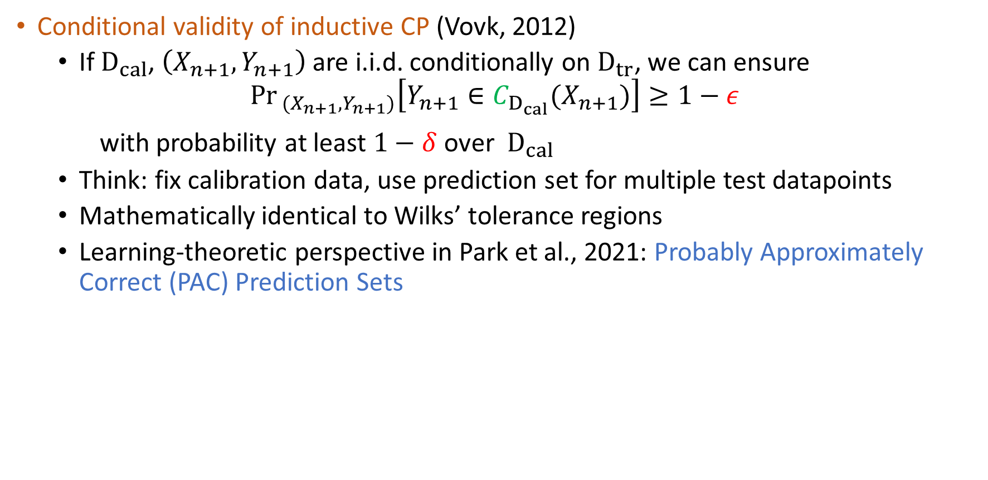
Conditional Validity of Inductive CP
Conditional validity of inductive CP (Vovk, 2012)
If${ D}_{cal}$, $\left(X_{n+1},Y_{n+1}\right)$are i.i.d. conditionally on $D_{tr}$, we can ensure
$${Pr}_{ (X_{n+1},Y_{n+1})}\left[Y_{n+1}∈C_{D_{cal}}(X_{n+1})\right]≥1−ε$$
with probability at least $1−δ$ over ${ D}_{cal}$
Think: fix calibration data, use prediction set for multiple test datapoints
Mathematically identical to Wilks’ tolerance regions
Learning-theoretic perspective in Park et al., 2021: Probably Approximately Correct (PAC) Prediction Sets
Notes:
Animate

Slide 11
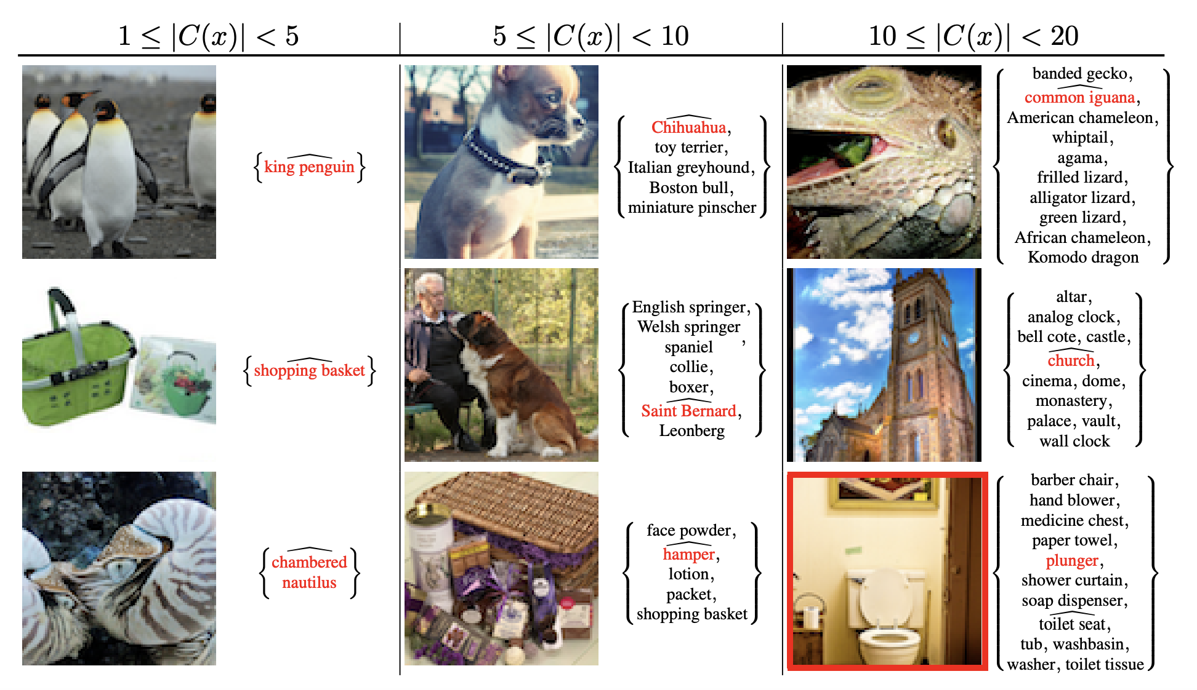
Examples on ImageNet

Slide 12
Extensions of PAC Prediction Sets
Often need to go beyond the i.i.d./exchangeable setting
Dataset shift (test distribution different from train/calibration dist.)
PAC Prediction Sets Under Covariate Shift (Park et al., ICLR 2022)
PAC Prediction Sets Under Label Shift (Si et al., 2023)
Meta-learning (multiple tasks, adapt to new ones)
PAC Prediction Sets for Meta-Learning (Park et al., NeurIPS 2023)

Slide 13
PAC Prediction Sets Under Covariate Shift
Sangdon Park, E. D., Insup Lee, Osbert Bastani (ICLR 2022)

Slide 14
Distribution Shift
Motivation: Models often face shifts in the data distribution
Robotics: Self-driving car in a new city
Healthcare: Transfer model to hospital with different patient population
Widely studied: Shimodaira, 2000; Sugiyama et al., 2007+; Ben-David et al., 2010; … (thousands of papers)
Conformal prediction: Tibshirani et al., 2019; Podkopaev and Ramdas 2021; Sesia et al., 2023, …

Slide 15
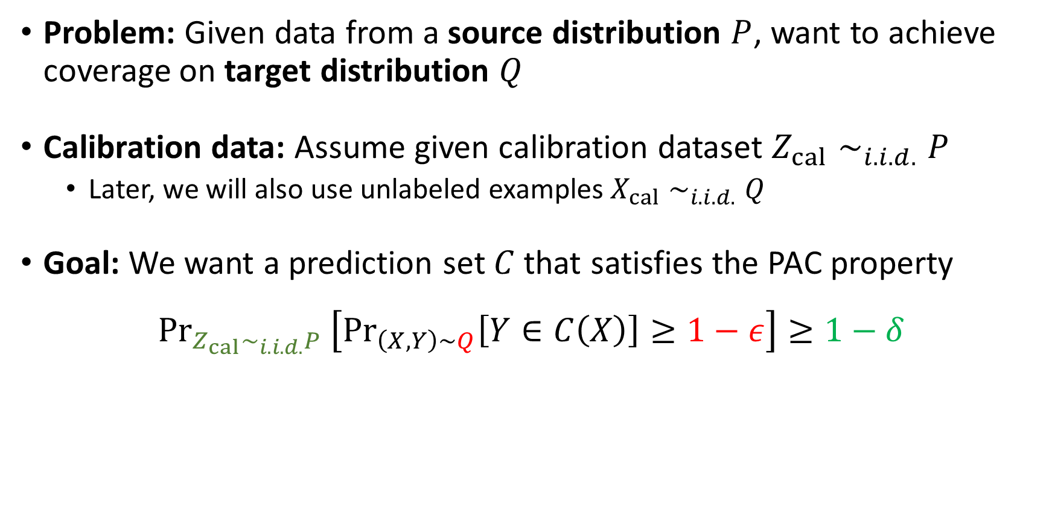
Problem Formulation
Problem: Given data from a source distribution $P$, want to achieve coverage on target distribution $Q$
Calibration data: Assume given calibration dataset $Z_{cal}∼_{i.i.d.}P$
Later, we will also use unlabeled examples $X_{cal}∼_{i.i.d.}Q$
Goal: We want a prediction set $C$ that satisfies the PAC property
$${Pr}_{Z_{cal}∼_{i.i.d.}P }\left[{Pr}_{\left(X,Y\right)∼Q}\left[Y∈C\left(X\right)\right]≥1−ε\right]≥1−δ$$

Slide 16
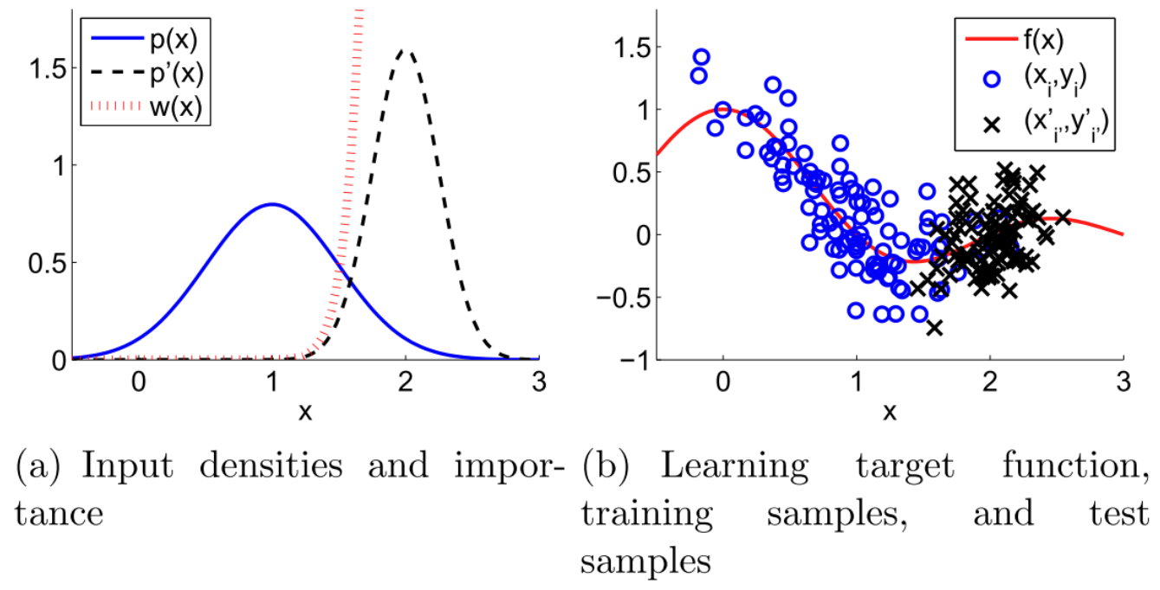
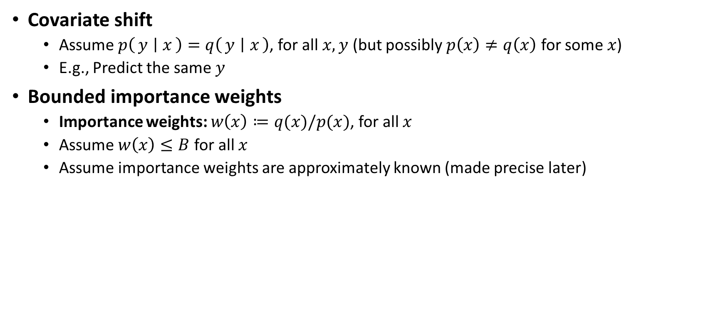
Problem Formulation
Covariate shift
Assume $p\left(y ∣ x\right)=q\left(y ∣ x\right)$, for all $x,y$ (but possibly $p\left(x\right)≠q\left(x\right)$ for some $x$)
E.g., Predict the same $y$
Bounded importance weights
Importance weights: $w\left(x\right)≔q(x)/p(x)$, for all $x$
Assume $w\left(x\right)≤B$ for all $x$
Assume importance weights are approximately known (made precise later)
Sugiyama et al., 2013

Slide 17
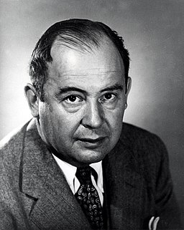


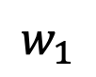
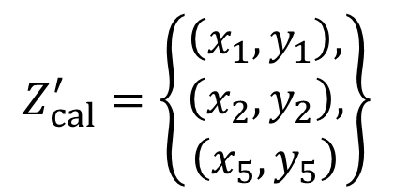
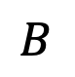
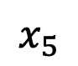
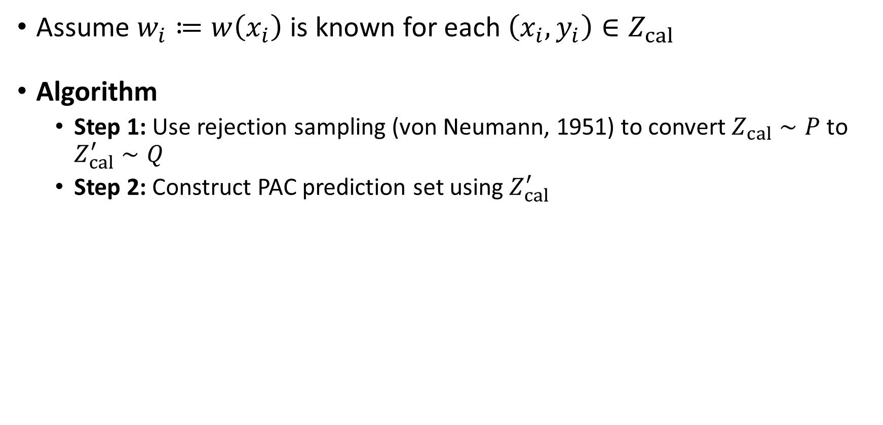
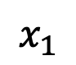
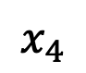
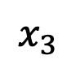
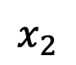
Case 1: Known Importance Weights
Assume $w_{i}≔w\left(x_{i}\right)$ is known for each $\left(x_{i},y_{i}\right)∈Z_{cal}$
Algorithm
Step 1: Use rejection sampling (von Neumann, 1951) to convert $Z_{cal}∼P$ to $Z_{cal}^{′}∼Q$
Step 2: Construct PAC prediction set using $Z_{cal}^{′}$
John von Neumann
$$Z_{cal}^{′}=\left\{\begin{matrix}\left(x_{1},y_{1}\right), \\ \left(x_{2},y_{2}\right), \\ \left(x_{5},y_{5}\right)\end{matrix}\right\}$$
$$B$$
$$w_{1}$$
$$x_{1}$$
$$x_{2}$$
$$x_{3}$$
$$x_{4}$$
$$x_{5}$$

Slide 18


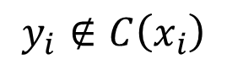
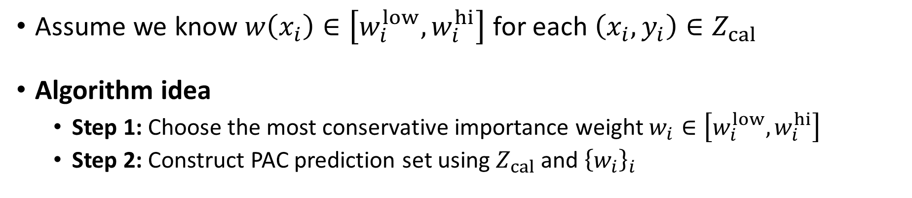
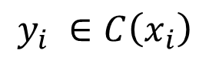
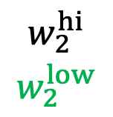
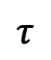
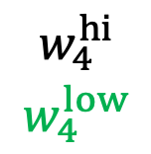
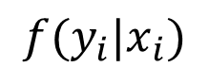
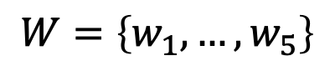
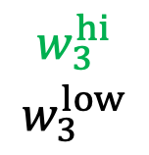
Case 2: Importance Weight Intervals
Assume we know $w\left(x_{i}\right)∈\left[w_{i}^{low},w_{i}^{hi}\right]$ for each $\left(x_{i},y_{i}\right)∈Z_{cal}$
Algorithm idea
Step 1: Choose the most conservative importance weight $w_{i}∈\left[w_{i}^{low},w_{i}^{hi}\right]$
Step 2: Construct PAC prediction set using $Z_{cal}$ and ${\left\{w_{i}\right\}}_{i}$
$$τ$$
$$f(y_{i}|x_{i})$$
$$W=\left\{w_{1},…,w_{5}\right\}$$
$$\begin{matrix}w_{4}^{hi} \\ w_{4}^{low}\end{matrix}$$
$$\begin{matrix}w_{2}^{hi} \\ w_{2}^{low}\end{matrix}$$
$$\begin{matrix}w_{5}^{hi} \\ w_{5}^{low}\end{matrix}$$
$$\begin{matrix}w_{1}^{hi} \\ w_{1}^{low}\end{matrix}$$
$$\begin{matrix}w_{3}^{hi} \\ w_{3}^{low}\end{matrix}$$
$$z_{4}$$
$$z_{2}$$
$$z_{5}$$
$$z_{1}$$
$$z_{3}$$
$$y_{i} ∈C\left(x_{i}\right)$$
$$y_{i}∉C\left(x_{i}\right)$$

Slide 19
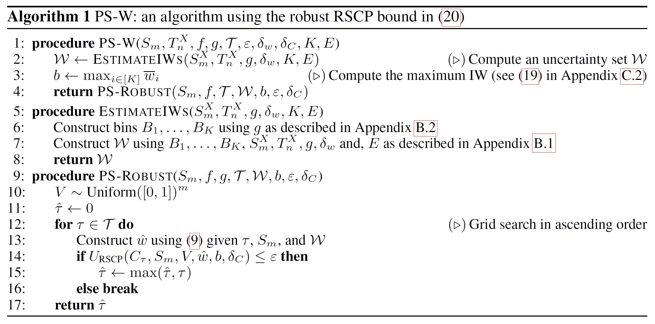
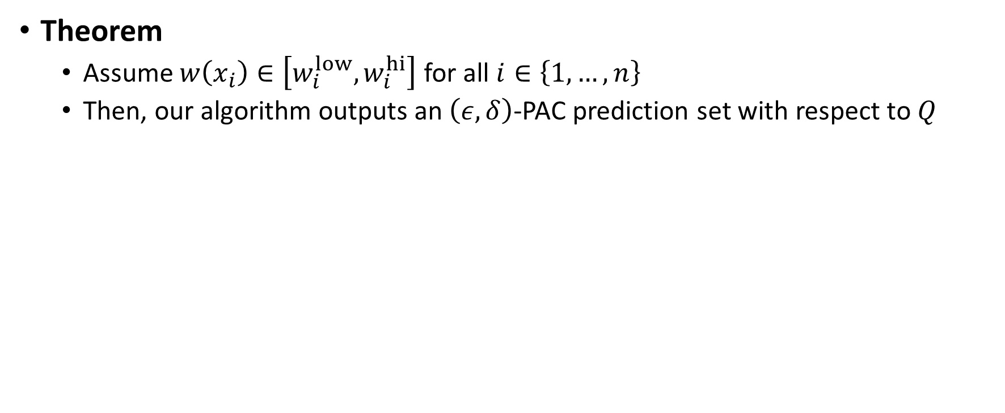
Theoretical Analysis
Theorem
Assume $w\left(x_{i}\right)∈\left[w_{i}^{low},w_{i}^{hi}\right]$ for all $i∈\left\{1,…,n\right\}$
Then, our algorithm outputs an $\left(ε,δ\right)$-PAC prediction set with respect to $Q$

Slide 20







Constructing Importance Weight Intervals
Consider unlabeled data $X_{cal}∼Q_{X}$from target distribution
Heuristic
Step 1: Train a probabilistic source-target classifier $\hat{g}:X→\left[0,1\right]$
Step 2: Bin importance weights, and construct interval for each bin
$$g\left(x\right)<\frac{1}{2}$$
$$g\left(x\right)≥\frac{1}{2}$$
$$\hat{w}\left(x\right)=\frac{1}{\hat{g}\left(x\right)}−1$$
$$w_{1}±e_{1}$$
$$w_{2}±e_{2}$$
$$w_{3}±e_{3}$$

Slide 21

Examples on DomainNet
Source: six domains
(sketch, painting, real, …).
Target: one domain.
- PS: PAC Pred. Set
- PS-W: PAC Pred. Set with Cov. Shift Adaptation

Slide 22

ImageNet Experiments
- PS: PAC Pred. Set
- WSCI: Weighted Split CP (Tibshirani et al., 2019)
- PS-C: Upper bound weights by B
- PS-W: PAC Pred. Set with Cov. Shift Adaptation

Slide 23
Related Work
Conformal prediction with covariate shift (Tibshirani et al., 2019)
Marginal coverage
Theory for known importance weights
Other distribution shifts
Label shift (Podkopaev and Ramdas, 2021; Sesia, Wang and Tong, 2023, Si et al., 2023)
Arbitrary shifts (Xu and Xie, 2021; Gibbs and Candes, 2021, 2022; Zaffran et al., 2022; Bastani et al.; 2022, …)
Total variation bounded shifts (Barber et al., 2022; D. and Yu, 2023; …)

Slide 24







Discussion
Estimating the weights can be handled rigorously using semiparametrics (Qiu, D., Tchetgen-Tchetgen, 2023, JRSS-B)
Label shift:
Weights are finite dimensional (dim. equal to number of labels)
Different approach: propagating confidence intervals for the weights through a linear system (Si, Park, D., Lee, Bastani, 2023)
Thank you!

